Slide 1

Department of Computer Science and Engineering
“Vehicle Inventory"
Presentation by,
Under the Guidance of,
Name: ARPIT DAGA
USN : 1NH20CS303
Section: E
Semester: 5
Lakshmi Hanne

Slide 2

Vehicle Inventory
Arpit daga
1NH20CS303

Slide 3

Introduction
A vehicle inventory system is a software application or set of tools used to manage and track a fleet of vehicles. This can include managing vehicle records, such as make, model, year, and mileage, as well as tracking the location and status of each vehicle. A vehicle inventory system may also include features for scheduling maintenance, generating reports, and monitoring fuel usage. Vehicle inventory systems are commonly used by businesses or organizations that have a large number of vehicles, such as rental car companies, fleet management companies, or government agencies. These systems can help organizations keep track of their vehicles, optimize their use, and reduce maintenance costs

Slide 4

METHODOLOGY
While adding vehicles to inventory items, the user has to enter the vehicle name, its model, year, color, and mileage. The system shows the inventory record in a list view. Also, the user easily delete any inventory items. The user can search for an item as it contains a search function too. In short, this projects mainly focus on CRUD with a search function.

Slide 5

Features:
*Add Vehicle to Inventory Menu
From this menu you can add new vehicle information by entering some needed information such as Vehicle make, Model, Year, Color and Mileage.
*Delete Vehicle from Inventory Menu
In this menu you can dynamically remove a vehicle information by entering the ID of the vehicle.
*View Current Inventory Menu
From here you are allowed to view all the current vehicle in the database.
*Update Vehicle in Inventory Menu
In this menu you can update the current vehicle list by entering the ID of that vehicle.
*Export Current Inventory Menu
For this menu you can export your current Inventory as a readable Text file

Slide 6

OBJECTIVES :
The main objectives of the project are:
To help organizations keep track of their vehicles
To optimize their use, and reduce maintenance costs

Slide 7
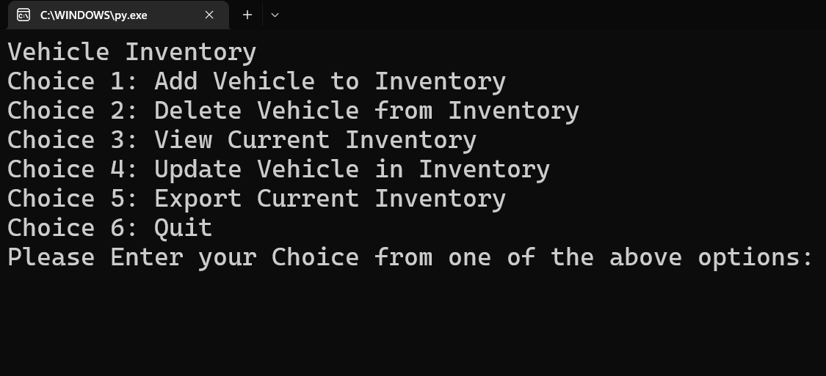
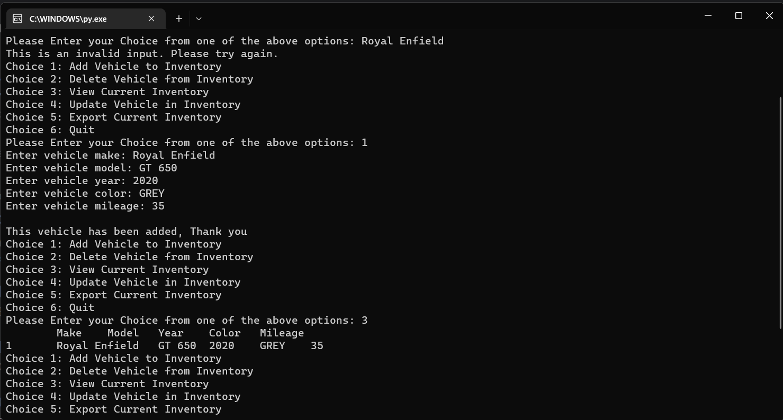
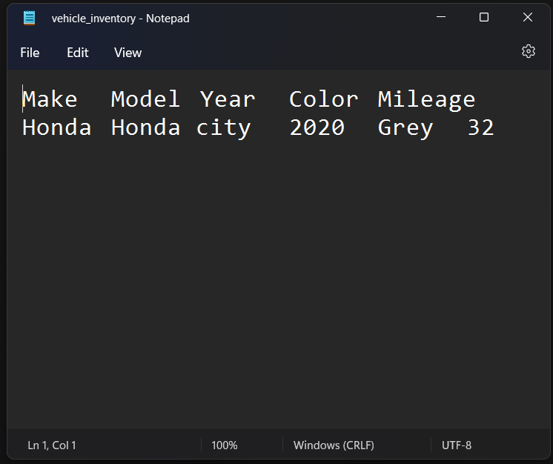
User interface :

Slide 8
SOFTWARE AND HARDWARE REQUIREMENTS
1)CPU: Intel or AMD processor with 64-bit support. Recommended 2.8 GHz or faster processor
2)GPU: nVidia GeForce GTX 1050 or equivalent:
Recommended nVidia GeForce GTX 1660 or Quadro T1000
3)Disk Storage: 4 GB of free disk space
4)Monitor Resolution: 1280x800 Recommended:
1920x1080
Software requirements are:
SP1: Recommended Windows 10
2 :Compiler: code blocks complier or Dev C

Slide 9
THANK YOU
ARPIT DAGA – 1NH20CS303

